Slide 1
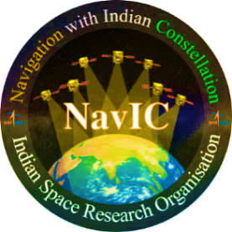
WEBINAR
on
Emerging Trends in Time and Frequency Systems
Organised by
Navigation Systems Area, ISTRAC, ISRO
January 11-15, 2021
January 11, 2021 1400-1500 IST | Timescale systems | Dr Andreas Bauch, Phyikalisch-Technische -Bundesanstalt (PTB), Germany
January 12, 2021 1400-1500 IST | Vapour cell atomic clocks and the measurement of time | Dr Gaetano Mileti, University of Neuchâtel, Switzerland
January 13, 2021 1400-1500 IST | Optical Frequency Combs & Ultrastable Lasers | Dr Sandra de Vega, Menlo Systems
January 14, 2021 1800 - 1900 IST | Precise Time transfer | Dr Demetrios Matsakis, MasterClock Inc., (former Chief Scientist for Time Services at the U.S. Naval Observatory)
January 15, 2021 1400-1500 IST | Synchronization and control of atomic clocks Passive Hydrogen Masers: current state and development in Vremya-CH | Dr Konstantin Mishagin, Vremya-CH Dr Anton Skryl, Vremya-CH
Register @
Webinar @

Slide 2
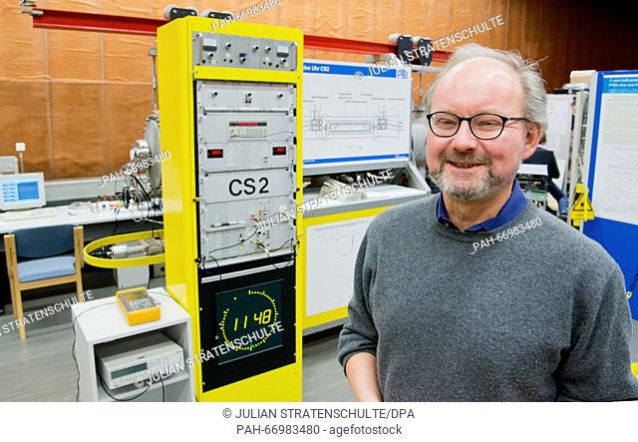
Speaker’s profile
Dr Andreas Bauch
Dr Andreas Bauch joined Phyikalisch-Technische Bundesanstalt, Braunschweig, Germany (PTB) as a PhD student, being initially engaged in studies on frequency shifting effects in caesium atomic clocks.
He got his PhD from Johannes-Gutenberg University, Mainz, Germany. Since then he has been involved in time and frequency metrology, focused at first on the development and operation of atomic clocks, later more and more on time comparison techniques (GNSS, TWSTFT).
Dr Bauch became responsible for PTB’s Time Unit Laboratory in 1991. Today he is Head of PTB’s Time Dissemination Working Group and as such has the management responsibility for the operation of PTB’s time dissemination services.
He has served as delegate to the Consultative Committee for Time and Frequency (CCTF) and to the Study Group 7 of the International Telecommunication Union. Between 2009 and 2013 he chaired the EURAMET Technical Committee for Time and Frequency. Since 2009 he is member of ESA’s GNSS Science Advisory Committee which he chaired between 2012 and 2015.
Dr Bauch has authored and co-authored more than 100 papers in refereed journals and conference proceedings.
Dr. Andreas Bauch received the I. I. Rabi Award of the IEEE “in recognition of outstanding contributions to the development, evaluation and operation of primary frequency standards”.

Slide 3
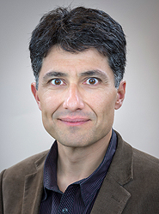
Speaker’s profile
Dr Gaetano Mileti
Dr Gaetano Mileti received his Diploma degree in physics from École Polytechnique Fédérale de Lausanne (EPFL), Lausanne, in 1990 and his Ph.D. degree in physics from the University of Neuchâtel, Neuchâtel, Switzerland, in 1995. From 1991 to 1995 and from 1997 to 2006, he was a research scientist at Observatoire Cantonal de Neuchâtel, where he became group leader in 2001. From 1995 to 1997, he was guest scientist at NIST, Boulder (CO). In 2007, he co-founded the Laboratoire Temps-Fréquence (LTF) at the University of Neuchâtel, Neuchâtel, Switzerland, where he is deputy director and Professor.
His research interests include atomic spectroscopy, stabilized lasers, and frequency standards. He took part in the development of space qualified (Galileo EU GNSS system) and industrial lamp-pumped Rb clocks (1991-1995) and in the Swiss primary Cs continuous fountain (1999-2001).
Dr Mileti was Chairman of the Scientific Committee of the EFTF (European Frequency and Time Forum) for the 2013 edition (Prague, co-chair of the joint IEEE UFFC-EFTF-PFM), 2014 edition (Neuchâtel, member of the Local Organising Committee) and 2015 edition (Denver, joint IEEE IFCS-EFTF). In 2019, he was co-chair of the joint IEEE IFCS-EFTF held in Orlando. Dr Mileti is member of the Scientific and of the Executive Committee of the EFTF since 2012 and member of Technical Program Committee of the IEEE International FCS (Frequency Control Symposium) since 2013.
Dr Gaetano Mileti is the author and co-author of approximately 300 scientific communications, including 62 articles in peer-reviewed journals.

Slide 4
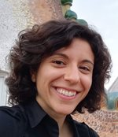
Speaker’s profile
Dr Sandra de Vega
Dr Sandra de Vega did her B.Sc. in Physics and M.Sc. in Photonics from Complutense University of Madrid and Polytechnic University of Catalonia, Barcelona (Spain). She received her PhD in Photonics from the Institute of Photonic Sciences (ICFO), Barcelona (Spain).
Dr de Vega joined Menlo Systems in March 2020. Her research interest includes Optical Frequency Combs & Ultrastable Lasers.

Slide 5
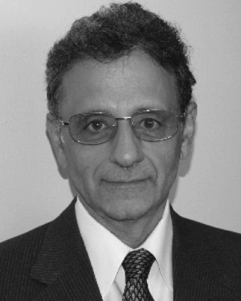
Speaker’s profile
Dr Demetrios Matsakis
Dr. Demetrios Matsakis received his undergraduate degree in Physics from MIT. His PhD was from U.C. Berkeley, and his thesis, under Nobel Laureate Charles Townes, involved building masers and using them for molecular radio astronomy and interferometry. Originally hired at the USNO in 1979, his first 18 years there were devoted to measuring variations in the Earth’s rotation and orientation using Connected Element Interferometry and Very Long Baseline Interferometry
Dr Matsakis has been Chief Scientist for Masterclock, Inc. since his retirement in 2019 as Chief Scientist for Time Services at the U.S. Naval Observatory, and also holds a part-time position as a faculty in Virginia Tech. In his 40 years at the USNO he worked on most aspects of precise timekeeping, served 16 years as Director of the Time Service department, served three years as President of the International Astronomy Union’s time commission, and represented the United States in Geneva as Vice-president of the ITU WP7a delegation. He has published over 160 scientific papers and secured one patent.
He has also published five short stories that are admittedly science fiction, and his blogs can be found below www.masterclock.com.

Slide 6
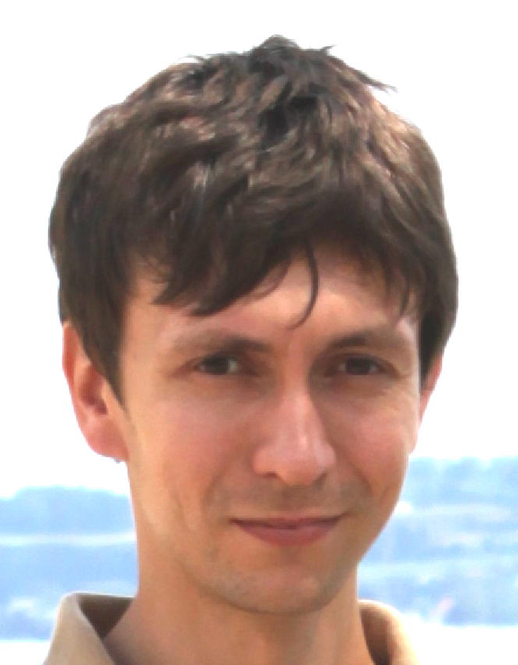
Speaker’s profile
Dr Konstantin Mishagin
Dr. Konstantin Mishagin graduated from University of Nizhny Novgorod. He received his PhD in 2007 in “Radiophysics”. He specialized in nonlinear dynamics of coupled phase locked loops in application to the problems of coherent power combining, beam steering in active phased arrays and wideband communications.
In 2008, Dr Mishagin joined the Vremya-CH company and started active R&D work in the field of precise phase and frequency measurements, phase noise analysis of atomic clock signals, paper clock and automatic steering algorithms. During his work he participated and headed the design of 9 atomic clock ensemble systems.
Dr Mishagin works as a head of IT department in Vremya-CH. He also has a partial position at the University of NN as an associate professor.

Slide 7
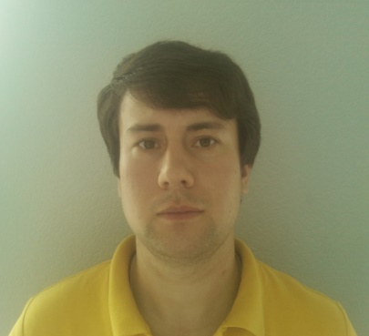
Speaker’s profile
Dr Anton Skryl
Dr Anton Skryl graduated from University of Nizhny Novgorod in 2011. He received his PhD in 2015 in “Laser physics”. He has specialized in high-resolution Terra Hertz spectroscopy.
In 2010, Dr Anton Skryl joined Vremya-CH company and started active R&D work in the field of PHM and AHM design. Also he participated in Rb fountain clock development project and the onboard PHM project.
Dr Skryl works as a head of AHM and PHM design department in Vremya-CH.

